Slide 1
Examining cognitively plausible RNN models for linguistic tasks
Gantavya Bhatt 2016EE10694
Hritik Bansal 2016EE10071
26 Nov 2019

Slide 2
Introduction
Cognitive and biologically inspired neural networks
RNN connections are analogous to neural synapses
EIRNN inculcates Dale’s principle(excitatory and inhibitory connections)
LSTM, GRU and its variants are highly sophisticated engineered models
Accessing the ability to capture syntax-level dependencies through linguistic tasks
Subject Verb Agreement Task(Restricted)
Grammaticality(Less Restricted)
Language Modeling(General)
Can we come up with a metric to generalize the recurrent structures based on their performance on these linguistic tasks?

Slide 3
Tasks Description
Subject Verb Agreement as an evidence of Syntax Dependencies
The key is on the table / *The key are on the table [ Look at the number of verb and head !! ]
The keys to the cabinet are on the table [ Presence of intervening nouns with opp. Number !! ]
Grammaticality Judgements
Predict if the sentence if grammatical or not with input as complete sentence
Weak supervision - Unlike previous objectives, it doesn’t give any syntactic cues to the model
Language Modeling
The goal of the network is to predict next word at each point in every sentence
The keys to the cabinet : P(are) > P(is) ?

Slide 4
Noun Attractors
A chair created by a hobbyist as a gift to someone is not a commodity.
N = 3 ; A = 0
A combination of liver function tests* is essential to arrive at a diagnosis.
N = 3 ; A = 1
All parts of the body* except the heart* and lungs continue to function normally .
N = 3 ; A = 2
d) Accusations of sock* puppetry* from this person* are humourous at best.
N = 3 ; A = 3
It is important that our model performs well when all the intervening nouns are attractors.

Slide 5
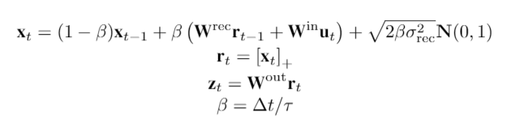
EIRNN
EiRNN models RNN from LDS perspective. It also take’s Dale Principle of Excitatory Inhibitory connections inside a neuron clusture. [Song et.al]

Slide 6
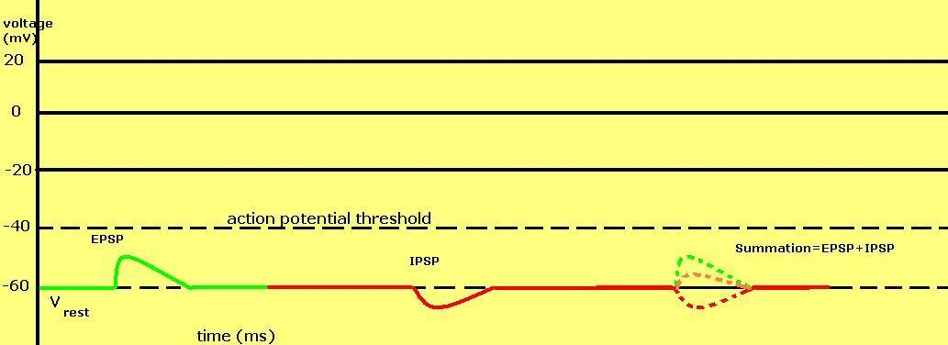
Dale’s Principle
A neurological phenomena which claims that in a neuron clusture, 20% of the synaptic connections are inhibitory and rest are excitatory. [courtesy - Wikipedia]

Slide 7
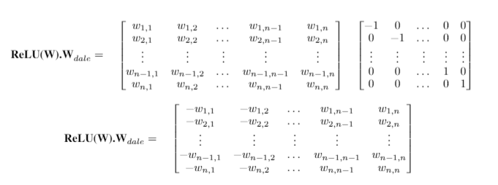
Implementation

Slide 8
Decay RNN
A model which is in between LSTM and RNN.
Note that here hidden state is bounded in contrast to hidden state in EIRNN.
⍺, the decay factor is a learnable parameter.

Slide 9
Future Prospects after
last presentation
Decay RNN : As per current settings, the decay parameter is not bounded but,
What happens when the decay parameter is forced to be bounded ?
When can we see see the vanishing and exploding gradient situation, mathematically?
When our model can converge to existing sequence models?
Understand the relationship among different models according to their performance on language tasks
Predict Verb Number (Restricted)
Grammaticality (Less Restricted)
Language Modeling (General)

Slide 10

Results on Predict Verb Number(Restricted)

Slide 11
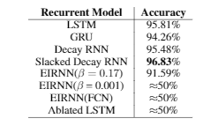
Results on Grammaticality(Less Restricted)
Slacked Decay RNN-
Decay RNN without Dale’s constraint
EIRNN(FCN) [Singh R. 2019]-
EIRNN in which full sentence is given as the input to the model
Ablated LSTM[Singh R. 2019]-
LSTM with learnable i,f gates which are independent of h and x

Slide 12
Further Analysis

Slide 13
Fixing constraints on ⍺
Note that our ⍺ values were not constrained till the previous settings. It was prone to get unbounded.
Therefore we applied 2 type of constraints:
⍺ +ve constraint :
+ve ⍺ constraint: Here we made a constraint to keep alpha as a positive number.
However, the results were same and there was no effect on accuracy.
⍺ bounded constraint :
In this constraint, we bounded ⍺ in (0, 1).
However, the results were same and there was no effect on accuracy.

Slide 14
Does training initialization matter?
Our previous diagnostic tests showed that ⍺ even after having constraints didn’t affect the accuracy of the model on PVN as well as Full Gram tasks.
However, to better analyze the learning of our model, we tried different initializations of ⍺ in our model. We saw that for the best learning, ⍺ should be initialized at 0.8.
We also saw that learning is achieved if ⍺ is initialized in between some certain interval which came out to be (-1,1)

Slide 15
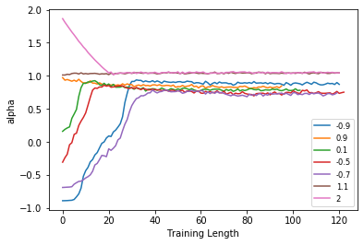
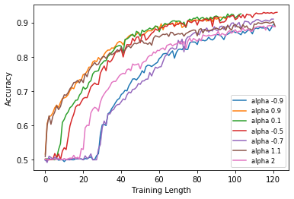
Different Initialisations of ⍺

Slide 16
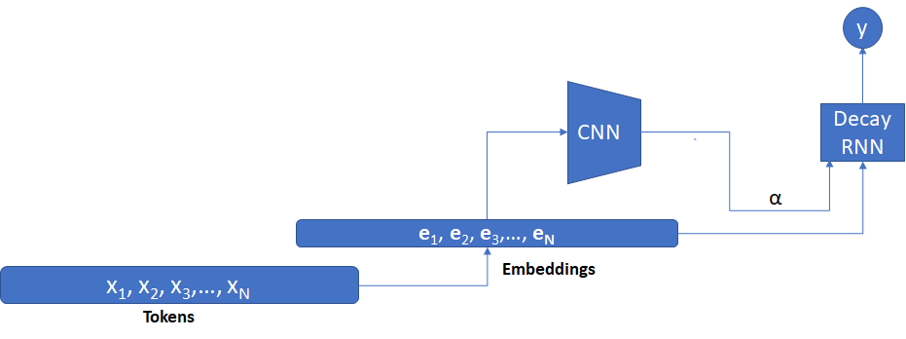
Should ⍺ matter on inputs?
To investigate the behavior of ⍺, we made a model which can learn alpha for every input.
It was seen idiosyncratically that ⍺ came out to be same for each input which was equal to 0.83.

Slide 17
Is Dale principle really important? Slacked Decay RNN
Dale principle is a neurologically inspired phenomena, however to see from optimization perspective, is this good for training? The answer is no. It was patent from our observations.
We made a new model where we slacked this Dale’s principle . We call that model as Slacked Decay RNN. The results of this model are already shown in the previous slides.

Slide 18
Language Modeling(General)
Language modeling is the art of determining the probability of a sequence of words.
We trained our models for Language Modelling task. Following are the results.
MODEL | Perplexity
LSTM | 148
Decay RNN | 950

Slide 19

Taxonomic Representation of Recurrent Structures
Analyzing the performance of various architectures on a particular task can give an insight about the effect of the design choices.
Learnable parameters/gates ; Dependence on Input ; Scalar or Vector(hadamard) products
Comparison for model accuracy for 1 intervening noun

Slide 20
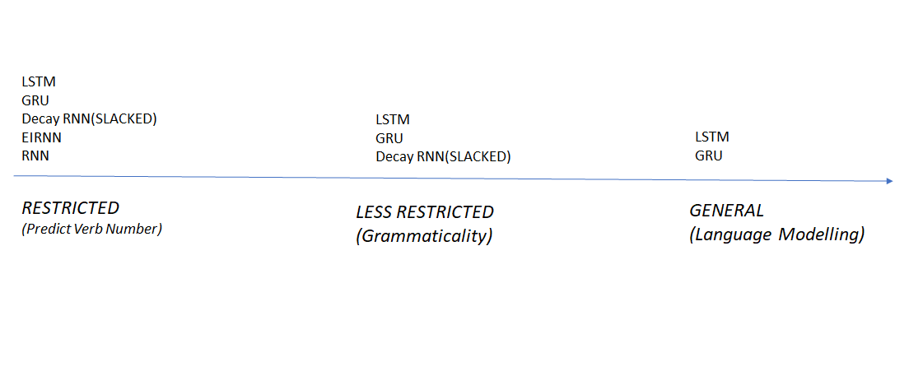
Spectrum

Slide 21
Future Prospects
Joint analysis of intervening nouns and count of attractors to identify if models can skip the opposite inflection.
Improving accuracy of Decay RNN on LM tasks by hyperparameter tunings, lr annealing, etc.
Developing a question generation framework (affirmative question) will improve syntax encoding.
Multitask learning for better prior impositions and information encoding. (CCG Supertags and Question construction.)

Slide 22
Acknowledgements
We want to acknowledge the work of Rishubh Singh, 2014 entry dual degree CSE student from IIT Delhi, who developed DecayRNN for a paper titled “RNNs as Cognitive Models for Learning Syntax-Sensitive Dependencies” with Prof. Sumeet Agarwal.
His Master's thesis also proved to be an excellent compilation of sufficient background material. His findings were compared against our results as a sanity check.

Slide 23
References
Tal Linzen, Emmanuel Dupoux, and Yoav Goldberg. 2016. Assessing the ability of LSTMs to learn syntax-sensitive dependencies. In TACL.
H Francis Song, Guangyu R Yang, and Xiao-Jing Wang. Training excitatory-inhibitory recurrent neural networks for cognitive tasks: A simple and flexible framework. PLoS Comput Biol, 12(2): e1004792, 2016.
Rebecca Marvin and Tal Linzen. Targeted syntactic evaluation of language models. arXiv preprint arXiv:1808.09031, 2018
Yikang Shen, Shawn Tan, Alessandro Sordoni, and Aaron Courville. 2019. Ordered neurons: Integrating tree structures into recurrent neural networks. In ICLR.
“Recurrent Nets as cognitive models”, Singh Rishubh, IIT Delhi
W. Yin, K. Kann, M. Yu, and H. Schütze, “Comparative study of CNN and RNN for natural language processing,” arXiv Preprint, arXiv:1702.01923, 2017

Slide 24
Thankyou!

